Slide 1
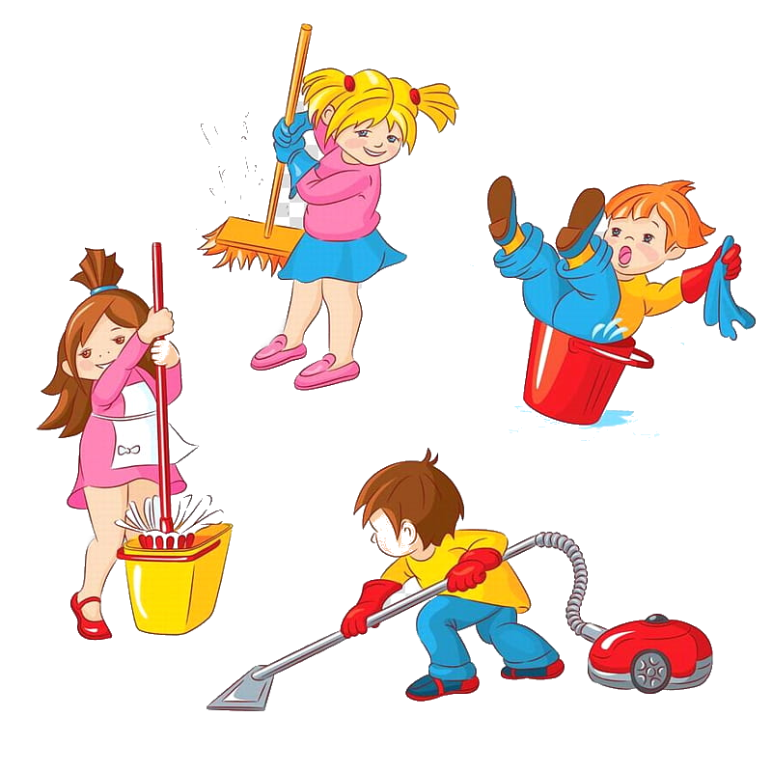
Review Unit 1-3
Grade 3

Slide 2
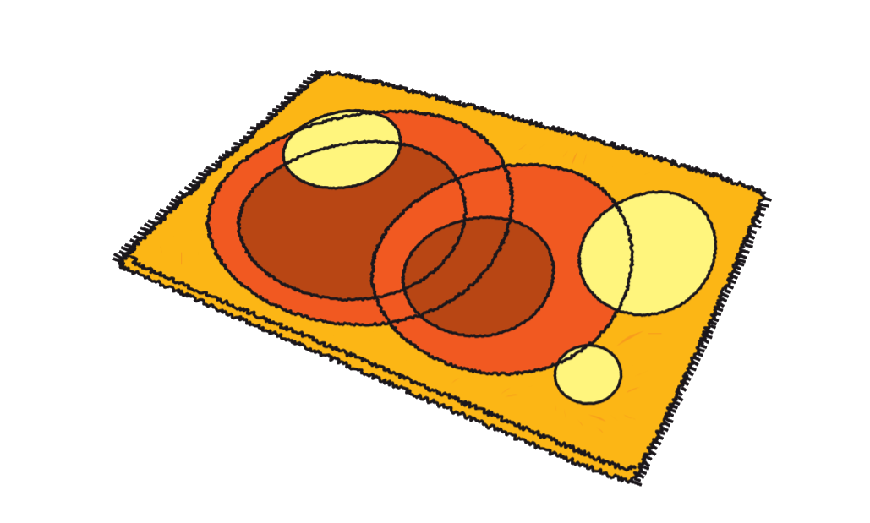
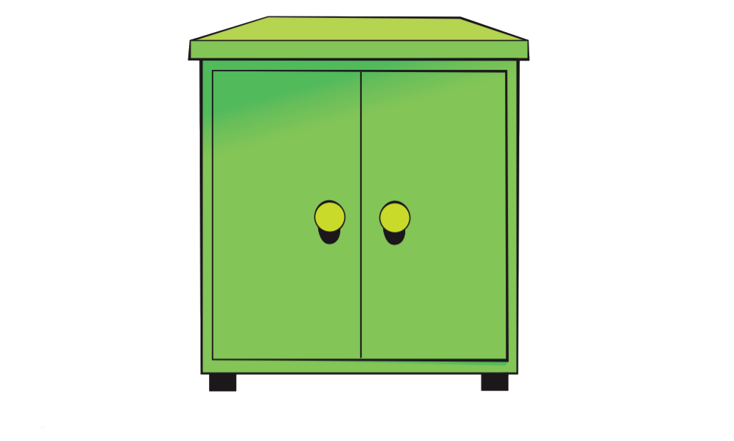
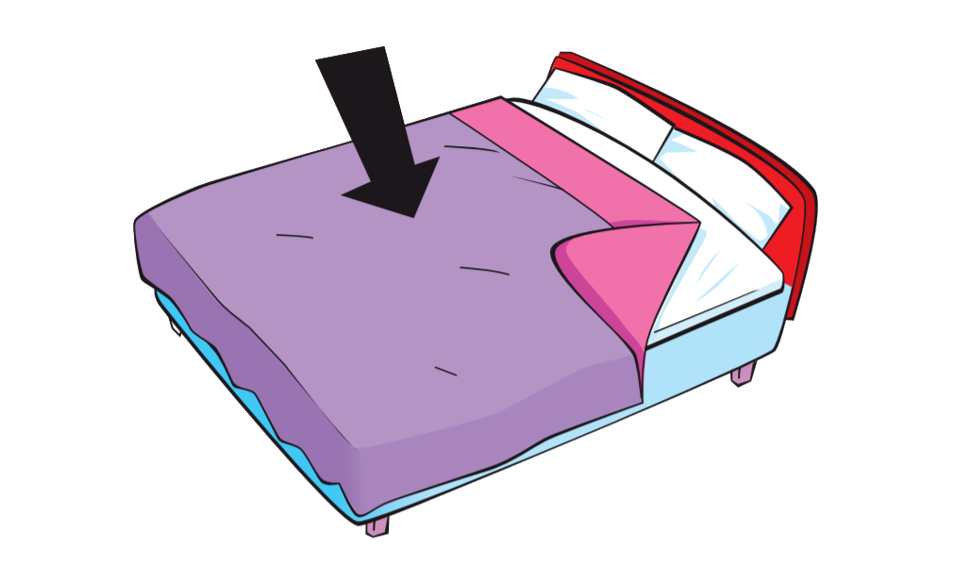
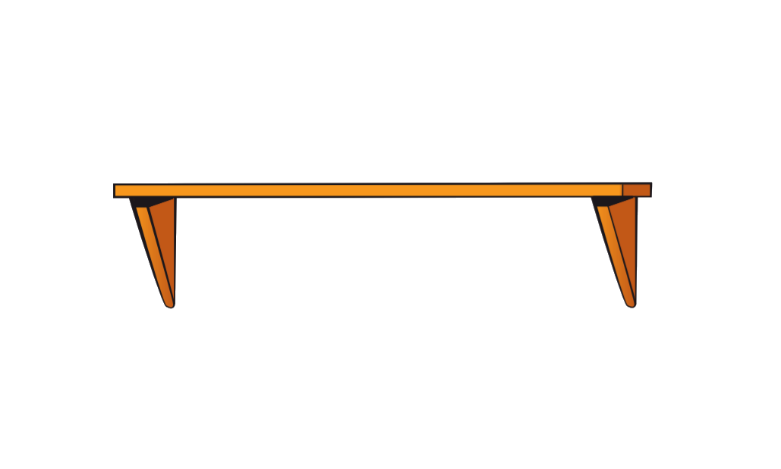
Words
Rug
Cabinet
Shelf
Pillow
Blanket

Slide 3
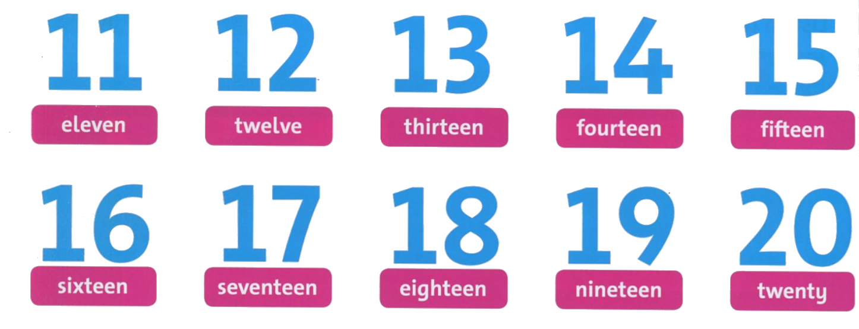
Numbers

Slide 4
There’s & There are

Slide 5
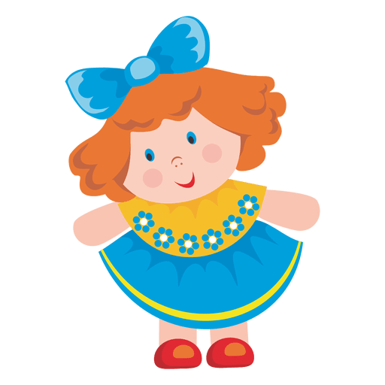
There is
a doll
.
There are
3 dolls
.

Slide 9
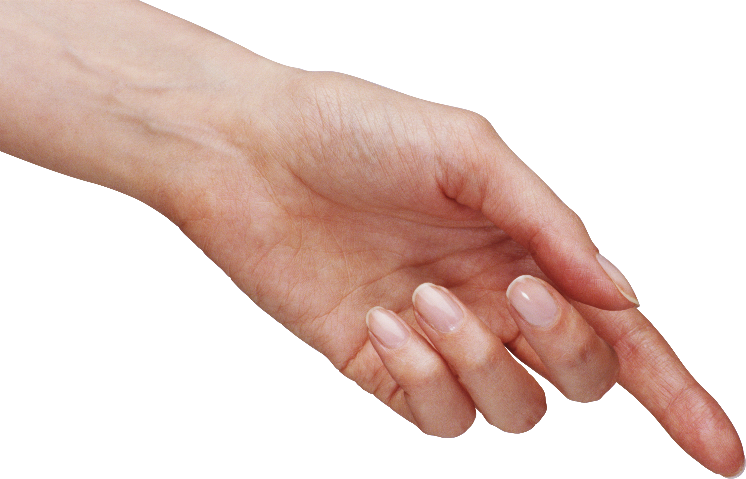
This is
a computer.
These are
computers.

Slide 10
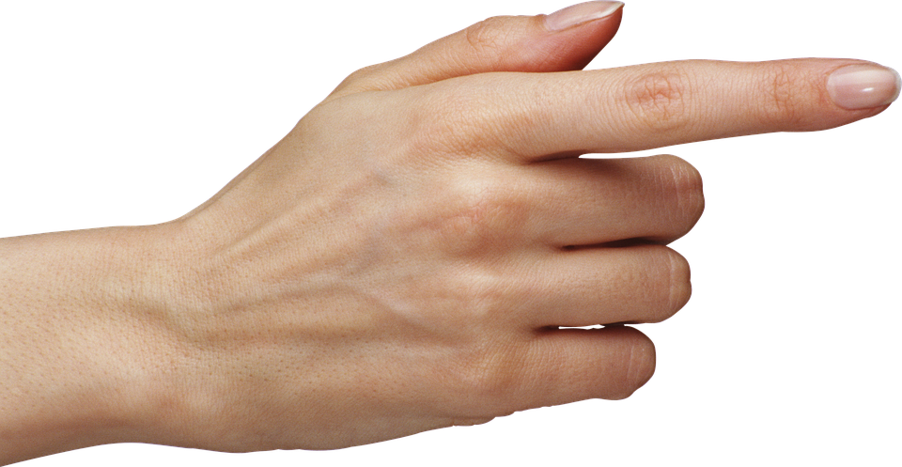
That is
a coat hook.
Th
Those are
coat hooks.

Slide 14
No, he doesn’t.
Yes, she does.

Slide 16
PRE
NEXT
rug
shelf
cabinet
pillow

Slide 17
PRE
NEXT
blanket
pillow
shelf
rug

Slide 18
PRE
NEXT
computer
pencil case
table
board

Slide 19
PRE
NEXT
chicken
pizza
milkshake
noodles

Slide 20
PRE
NEXT
board
pencil case
coat hook
table

Slide 21
PRE
NEXT
milkshake
pizza
noodles
salad

Slide 22
Goodbye~!

